Slide 1
A situation
Imagine that you are in a world where there were two possible states for weather: sunny or rainy. You can always directly observe the current weather state, and it is guaranteed to always be one of these two states.
In this world, there is an inherent transition in this process, in that the current weather has some bearing on what the next day’s weather will be. So, you collect weather data over several years, and calculate that the chance of a sunny day occurring after a rainy day is 0.5. The chance of a rainy day occurring after a sunny day is 0.1.

Slide 2
Given the current weather how do I find the probabilities of the weather in the future?

Slide 3
A visualization
Sunny
Rainy

Slide 4
A visualization
Chance of rainy day after a rainy day = 1 – 0.5 = 0.5
0.5
0.5
Sunny
Rainy

Slide 5
A visualization
Chance of sunny day after a sunny day = 1 – 0.1 = 0.9
0.9
0.5
0.5
Sunny
Rainy
0.1

Slide 6
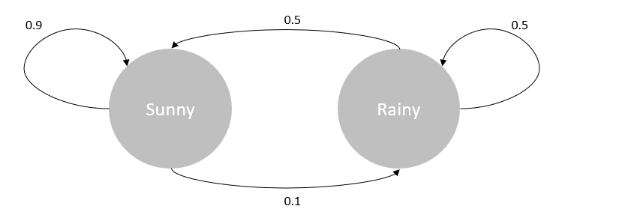
Given the current weather how do I find the probabilities of the weather in the future?
If current weather is Sunny?
If current weather is Rainy?
One day from now…
Two days from now…
N days from now… ?
Naïve calculation is hard and bulky.
At each step need to factor in all potential states before
Is there a way we can simplify this calculation?

Slide 7
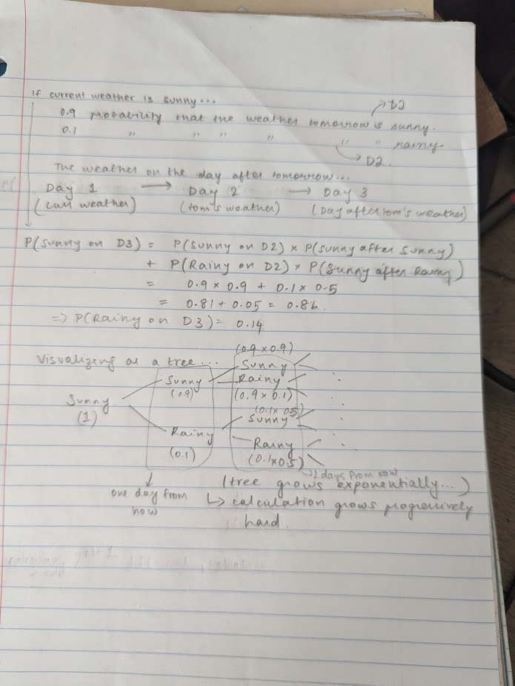

Slide 8
A new method of calculation…
Let us start by trying to model the situation better for scalability.
With two states, we need four arrows.
With three states we will need nine arrows.
With n states we will need n^2 arrows. Why?
A convenient data structure? A matrix!
0.7
0.1
0.5
Sunny
0.1
Rainy
0.3
0.4
0.4
0.2
Cloudy
0.3

Slide 9
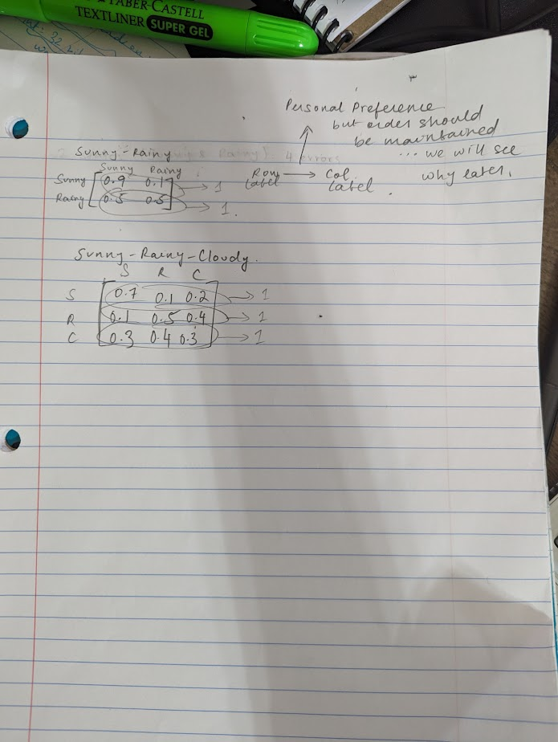

Slide 10
Key Observations
Sum of row entries is 1
Why is sum of column entries not 1?

Slide 11
How does this help us solve the problem?

Slide 12
Working backwards
If our solution was a matrix, what would we want it to look like?
Maybe a row vector or a column vector? Where one entry represents the future state being sunny and the other represents it being rainy?
How would we achieve this from the previous matrix?

Slide 13
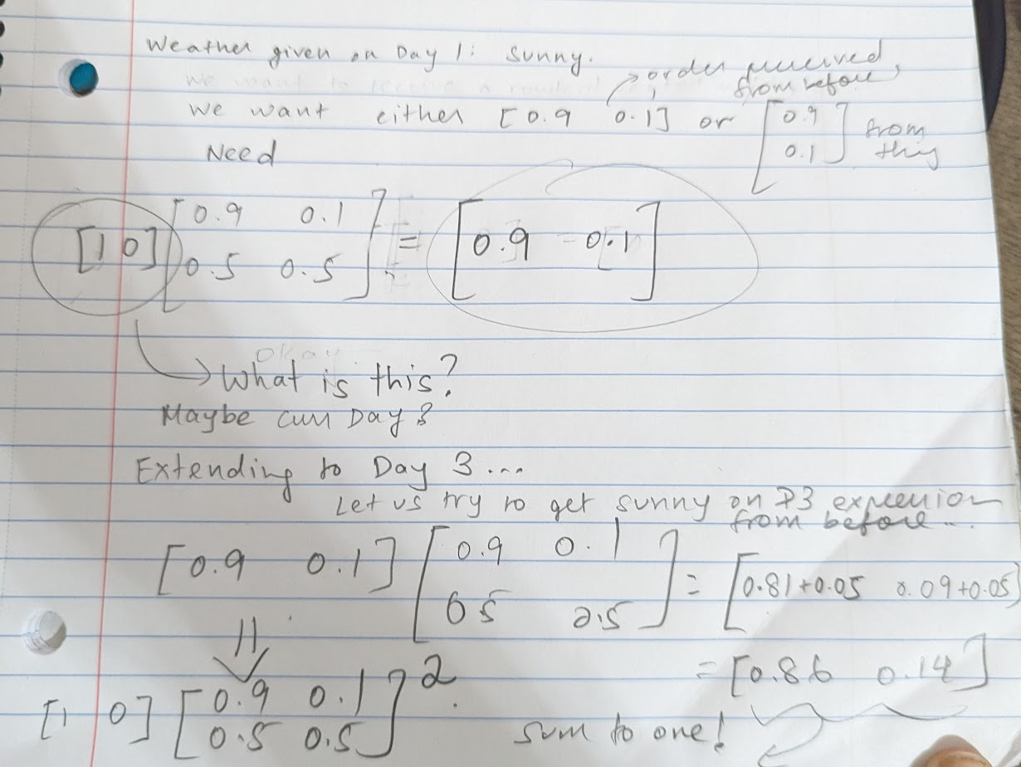

Slide 14
Hmmm
Will this tell us about Day N ?
Does this work for more than two states?
Let us try generalizing

Slide 15
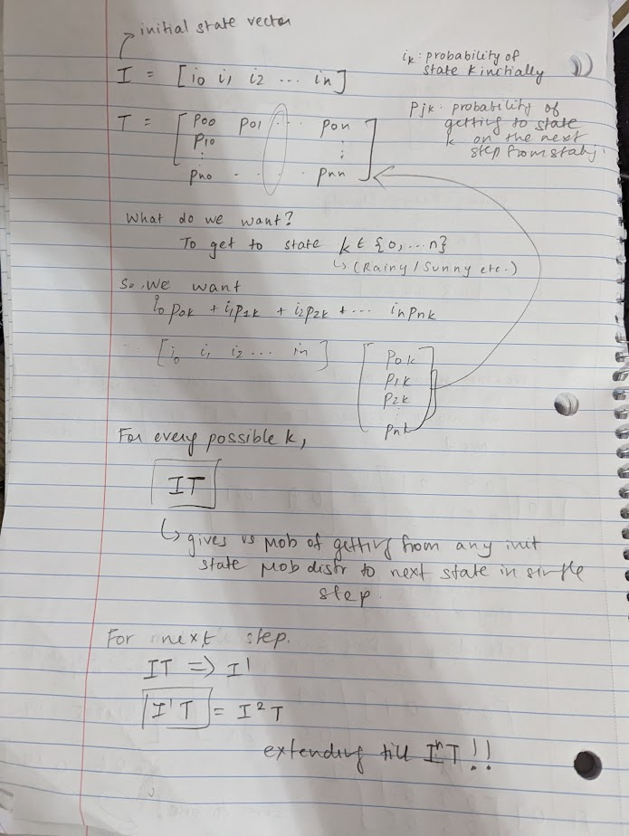

Slide 16
Some applications…
https://www.reddit.com/r/SubredditSimulator/
Drunkard’s Walk / Random Walks
Autocorrect

