Slide 1
MATH 3215 Section C – Poker Project Presentation
By Benjamin Skelton

Slide 2
Introduction
In a standard game of poker, players are dealt 5 random cards from a standard deck of 52 cards. There are (52 choose 5), or 2,598,960 possible distinct 5 card hands a player can be dealt.
Depending on the cards the player has, their cards can be designated as one of ten types of hands.
From least valuable to most valuable, the hands are No pair, One pair, Two pair, Three of a kind, Straight, Flush, Full House, Four of a kind, Straight flush, and Royal flush.

Slide 3
Probability of Getting Each Poker Hand
Every distinct 5-card hand is equally likely to be dealt, so to find the probability of getting each poker hand, we can count the number of possible 5-card hands that satisfy the conditions for a particular hand and divide that number by (52 choose 5) or 2,598,960, the total number of possible 5-card hands.

Slide 4
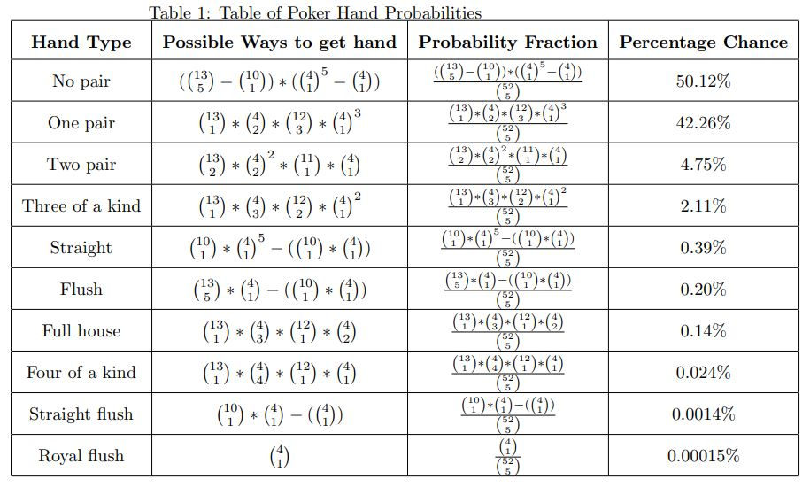

Slide 5
Probability of Getting a Better Poker hand than your opponent
Now that we know the probability of being dealt each poker hand from a standard deck, we have a more important question to ask. How likely is it that your poker hand is better than my opponent's hand?
Given that we know what 5 cards we have, we also know what 5 cards our opponents cannot get. Our opponent is dealt 5 random cards out of 47 remaining cards, leading to (47 choose 5), or 1,533,939 possible distinct hands our opponent can be dealt.
It would be extremely difficult, if not impossible for a human to examine all 2,598,960 5-card hands, so I have instead opted to examine a sample hand for each poker hand.

Slide 6
Royal Flush
Suppose that you have the hand 10h, Jh, Qh, Kh, Ah (10 of hearts, jack of hearts, queen of hearts, king of hearts, and ace of hearts).
Number of hands that can beat this royal flush hand: 0, a royal flush is the best possible hand.
Number of hands that tie with this hand (i.e., # of remaining royal flush hands): 3 royal flush hands.

Slide 7
Straight Flush
Suppose that you have the hand 6c, 7c, 8c, 9c, 10c (6 of clubs, 7 of clubs, 8 of clubs, 9 of clubs, and 10 of clubs).
Number of hands that can beat this straight flush hand: 3 royal flush hands, 3 total.
Number of hands that tie with this hand (i.e., # of remaining straight flush hands): 28 straight flush hands.

Slide 8
Four of a Kind
Suppose that you have the hand 5c, 5s, 5d, 5h, 2d (5 of clubs, 5 of spades, 5 of diamonds, 5 of hearts, and 2 of diamonds).
Number of hands that can beat this four of a kind hand: 4 royal flush hands, 20 straight flush hands, 24 total.
Number of hands that tie with this hand (i.e., # of remaining four of a kind hands): 473 four of a kind hands.

Slide 9
Full House
Suppose that you have the hand 9c, 9d, 9h, 4h, 4s (9 of clubs, 9 of diamonds, 9 of hearts, 4 of hearts, and 4 of spades).
Number of hands that can beat this full house hand: 1 royal flush hand, 13 straight flush hands, 473 four of a kind hands, 487 total.
Number of hands that tie with this hand (i.e., # of remaining full house hands): 2,684 full house hands.

Slide 10
Flush
Suppose that you have the hand 2d, 4d, 6d, 10d, Qd (2 of diamonds, 4 of diamonds, 6 of diamonds, 10 of diamonds, and queen of diamonds).
Number of hands that can beat this flush hand: 3 royal flush hands, 27 straight flush hands, 344 four of a kind hands, 2,124 full house hands, 2,498 total.
Number of hands that tie with this hand (i.e., # of remaining flush hands): 3,887 flush hands.

Slide 11
Straight
Suppose that you have the hand 3c, 4d, 5s, 6h, 7s (3 of clubs, 4 of diamonds, 5 of spades, 6 of hearts, and 7 of spades).
Number of hands that can beat this straight hand: 4 royal flush hands, 17 straight flush hands, 344 four of a kind hands, 2,124 full house hands, 2,817 flush hands, 5,306 total.
Number of hands that tie with this hand (i.e., # of remaining straight hands): 6,150 straight hands.

Slide 12
Three of a Kind
Suppose that you have the hand 7s, 7d, 7h, 3c, Ad (7 of spades, 7 of diamonds, 7 of hearts, 3 of clubs, and ace of diamonds).
Number of hands that can beat this three of a kind hand: 3 royal flush hands, 17 straight flush hands, 430 four of a kind hands, 2,526 full house hands, 2,818 flush hands, 5,356 straight hands, 11,150 total.
Number of hands that tie with this hand (i.e., # of remaining three of a kind hands): 35,486 three of a kind hands.

Slide 13
Two Pair
Suppose that you have the hand 4d, 4h, Ks, Kh, Jc (4 of diamonds, 4 of hearts, king of spades, king of hearts, and jack of clubs).
Number of hands that can beat this two pair hand: 1 royal flush hand, 23 straight flush hands, 430 four of a kind hands, 2,422 full house hands, 2,814 flush hands, 6,376 straight hands, 29,604 three of a kind hands, 41,670 total.
Number of that tie with this hand (i.e., # of remaining two pair hands): 68,395 two pair hands.

Slide 14
One Pair
Suppose that you have the hand 6c, 6s, 3d, 2h, 9s (6 of clubs, 6 of spades, 3 of diamonds, 2 of hearts, and 9 of spades).
Number of hands that can beat this one pair hand: 4 royal flush hands, 18 straight flush hands, 387 four of a kind hands, 2,271 full house hands, 2,816 flush hands, 5,834 straight hands, 33,075 three of a kind hands, 73,683 two pair hands, 118,088 total.
Number of hands that tie with this hand (i.e., # of remaining one pair hands): 867,891 one pair hands.

Slide 15
No Pair
Suppose that you have the hand Ad, 3h, 6c, 8c, 10s (ace of diamonds, 3 of hearts, 6 of clubs, 8 of clubs, and 10 of spades).
Number of hands that can beat this no pair hand: 2 royal flush hands, 21 straight flush hands, 344 four of a kind hands, 2,124 full house hands, 2,815 flush hands, 5,785 straight hands, 31,502 three of a kind hands, 71,802 two pair hands, 645,300 one pair hands, 759,695 total.
Number of hands that can tie with this hand (i.e., # of remaining no pair hands): 774,244 no pair hands.

Slide 16
Table of Probabilities
Hand Type | Chance to Win | Chance to Tie | Chance to Lose
Royal flush | 99.9998% | 0.00020% | 0%
Straight flush | 99.998% | 0.0018% | 0.00020%
Four of a kind | 99.9953% | 0.0031% | 0.0016%
Full house | 99.798% | 0.17% | 0.032%
Flush | 99.59% | 0.25% | 0.16%
Straight | 99.25% | 0.40% | 0.35%
Three of a kind | 96.96% | 2.31% | 0.73%
Two pair | 92.82% | 4.46% | 2.72%
One pair | 35.72% | 56.58% | 7.70%
No pair | 0% | 50.47% | 49.53%

Slide 17
Table of Probabilities (without ties)
Hand Type | Chance to Win | Chance to Lose
Royal flush | 100% | 0%
Straight flush | 99.9989% | 0.0011%
Four of a kind | 99.99685% | 0.00315%
Full house | 99.883% | 0.117%
Flush | 99.715% | 0.285%
Straight | 99.45% | 0.55%
Three of a kind | 98.115% | 1.885%
Two pair | 95.05% | 4.95%
One pair | 64.01% | 35.99%
No pair | 25.235% | 74.765%

Slide 18
Optimal Betting Strategy (one opponent)
If you have a two pair hand or better, you should definitely raise.
If you have a one pair hand, you have a somewhat greater odds of winning than losing, but do not discount the possibility of your opponent having a better hand.
If you have a no pair hand, you should probably fold. Your odds of losing are significantly higher than the odds of winning.

Slide 19
What if there is more than one opponent?
If you are hand is going up against multiple (non-folding) opponents, than your hand will have to beat all of your opponents' hand in order for you to win.
If the odds of your hand beating one opponent's hand is p, then the odds of your hand beating all of the hands of k opponent's should be p^k.

Slide 20
Table of Probabilities (without ties/two opponents)
Hand Type | Chance to Win | Chance to Lose
Royal flush | 100% | 0%
Straight flush | 99.9978% | 0.0022%
Four of a kind | 99.9937% | 0.0063%
Full house | 99.7661% | 0.2339%
Flush | 99.4308% | 0.5692%
Straight | 98.9030% | 1.0970%
Three of a kind | 96.2655% | 3.7345%
Two pair | 90.3450% | 9.6550%
One pair | 40.9728% | 59.0272%
No pair | 6.3681% | 93.6319%

Slide 21
Table of Probabilities (without ties/three opponents)
Hand Type | Chance to Win | Chance to Lose
Royal flush | 100% | 0%
Straight flush | 99.9967% | 0.0033%
Four of a kind | 99.9906% | 0.0094%
Full house | 99.6494% | 0.3506%
Flush | 99.1474% | 0.8526%
Straight | 98.3591% | 1.6409%
Three of a kind | 94.4509% | 5.5491%
Two pair | 85.8729% | 14.1271%
One pair | 26.2267% | 73.7733%
No pair | 1.6070% | 98.3930%

Slide 22
Optimal Betting Strategy (multiple opponents)
If the odds of your hand winning against all k opponents is greater than or equal 50%, then you should probably raise.
If the odds of your hand winning is less than 50%, then you should probably fold.
When going against two or three opponents, you should raise only if you have a two pair hand or greater.

Slide 23
What are the general odds of winning?
Suppose that you want to know the general odds of you winning any given poker game against k opponents?
To find these odds, we can start by multiplying the odds of getting a certain hand by the odds of wining with that hand to find the odds to find the probability of getting and then winning with a certain hand.
If we calculate the compound probability for each hand type using the formula above, then sum all of the compound probabilities, we can find the general odds of winning any given poker game.

Slide 24
Hand Type | Chance of Getting | Chance of Getting * Chance of Winning against 1 opponent | Chance of Getting * Chance of Winning against 2 opponents | Chance of Getting * Chance of Winning against 3 opponents
Royal flush | 0.00015% | 0.00015% | 0.00015% | 0.00015%
Straight flush | 0.0014% | ~0.0014% | ~0.0014% | ~0.0014%
Four of a kind | 0.024% | ~0.024% | ~0.024% | ~0.024%
Full house | 0.14% | ~0.14% | ~0.14% | ~0.14%
Flush | 0.20% | ~0.20% | ~0.20% | ~0.20%
Straight | 0.39% | ~0.39% | ~0.39% | 0.38%
Three of a kind | 2.11% | 2.07% | 2.03% | 1.99%
Two pair | 4.75% | 4.51% | 4.29% | 4.08%
One pair | 42.26% | 27.05% | 17.32% | 11.08%
No pair | 50.12% | 12.65% | 3.19% | 0.81%
Total | 100% | 47.04% | 27.59% | 18.71%

Slide 25
Can Poker be profitable over many games? Part 1
Now that we know the general odds of winning a poker game against 1, 2, or 3 opponents, we can calculate the odds of winning exactly y out of x given games using a PMF.
By summing the probabilities associated with winning a number of games (i.e., calculating a CMF), we can also find the probability of winning y or more games out of x given games.
Question: Given that you know how many opponents you will play against ahead of time, can you figure out how many consecutive games you would need to play before the odds of winning at least one game exceed 50%?

Slide 26
Can Poker be profitable over many games? Part 2
For 1 opponent, if you play 2 consecutive games, you have a 71.95% chance of winning at least one game.
For 2 opponents, if you play 3 consecutive games, you have a 62.03% chance of winning at least one game.
For 3 opponents, if you play 4 consecutive games, you have a 56.33% chance of winning at least one game.

Slide 27
Conclusion
Overall, we can see that the less opponents your hand has to face-off against, the better your odds of winning are.
To maximize your chances of winning, you should try bluffing that you have a good hand to convince your opponents to fold, regardless of the actual rank of your hand.
That being said, everyone knows that "the house always wins", you should never gamble more money than you are willing to lose.

